Slide 1
ENSE 477 Project Progress Vlog
Humane Transport
Clark Inocalla, Kelly Holtzman, Mansi Patel, Sana Khan
March 18, 2021

Slide 2
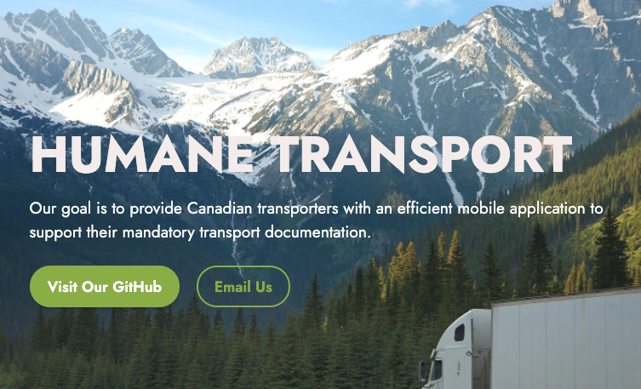

Slide 4
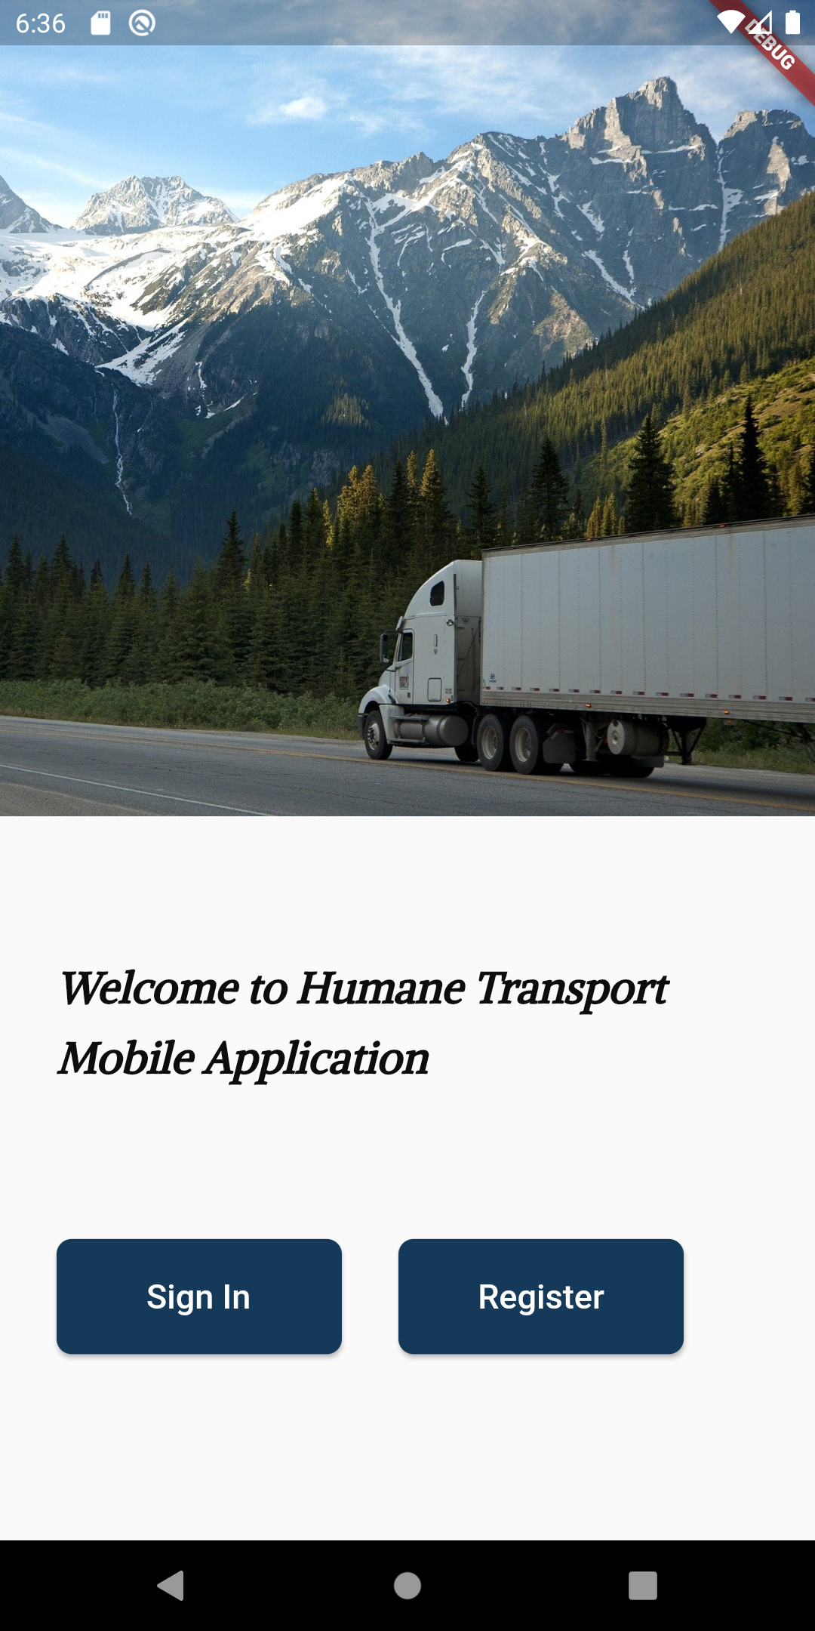
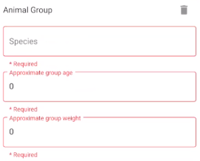
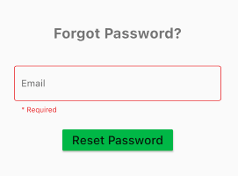
Sprint 9 So Far...
Mar 9, 2021 - Mar 23, 2021
Previews

Slide 5
Project Status Description
and Project Issues (No Changes)
Our project status is green.
There is still no transporter feedback.
We’re not likely to receive it in time.
Our future recommendations for the app include user testing with a group of willing Transporters.

Slide 6
Application Demo

Slide 7
Sprint 10 Outlook
Starts Mar 23, 2021, ends Apr 10, 2021
The project closing Sprint:
Remaining minor implementation and appearance updates
Closing documentation
Project poster
Project commercial
Project presentation

Slide 8
Project Reflection
Does the team feel "on track"?
What progress does the team particularly feel good about?
What barriers does the team feel is a current impediment to success?
What help does the team require to move positively forward?
Other questions or concerns?
?

Slide 9
Image References
Stoplight. http://clipart-library.com/traffic-light-cliparts.html

