Slide 1
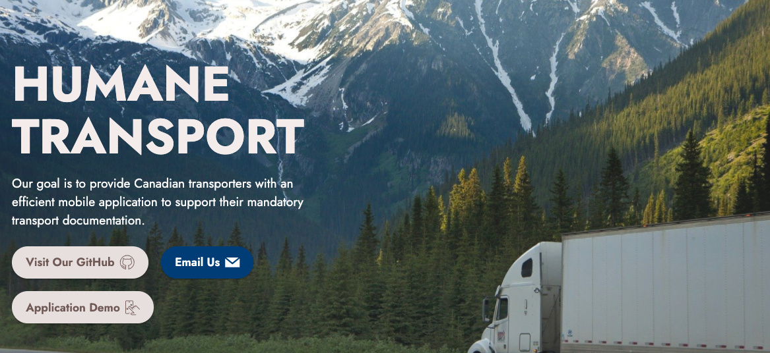

Slide 2
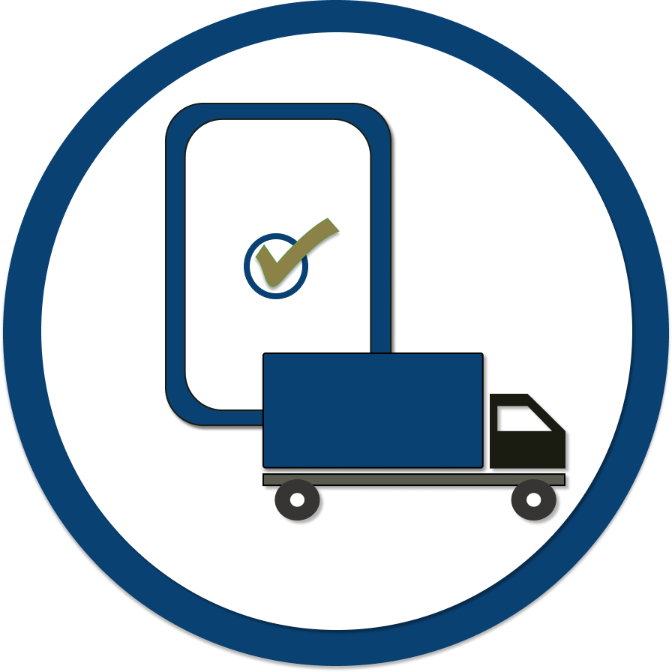
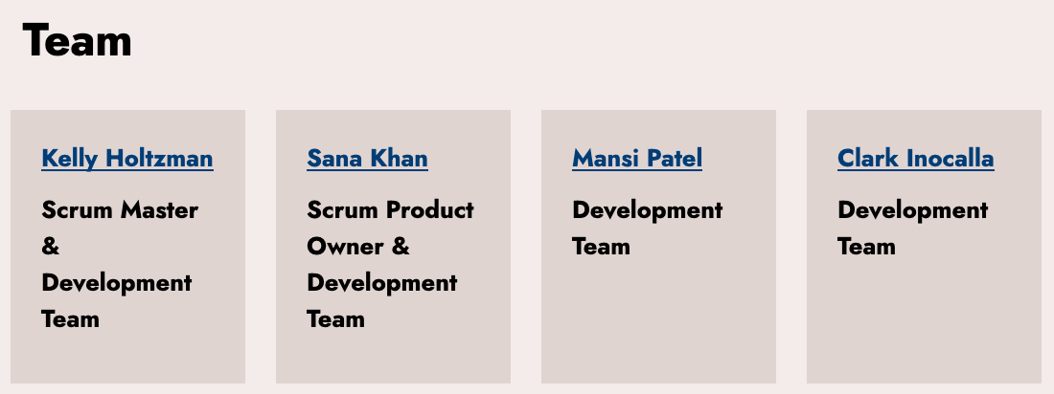

Slide 3
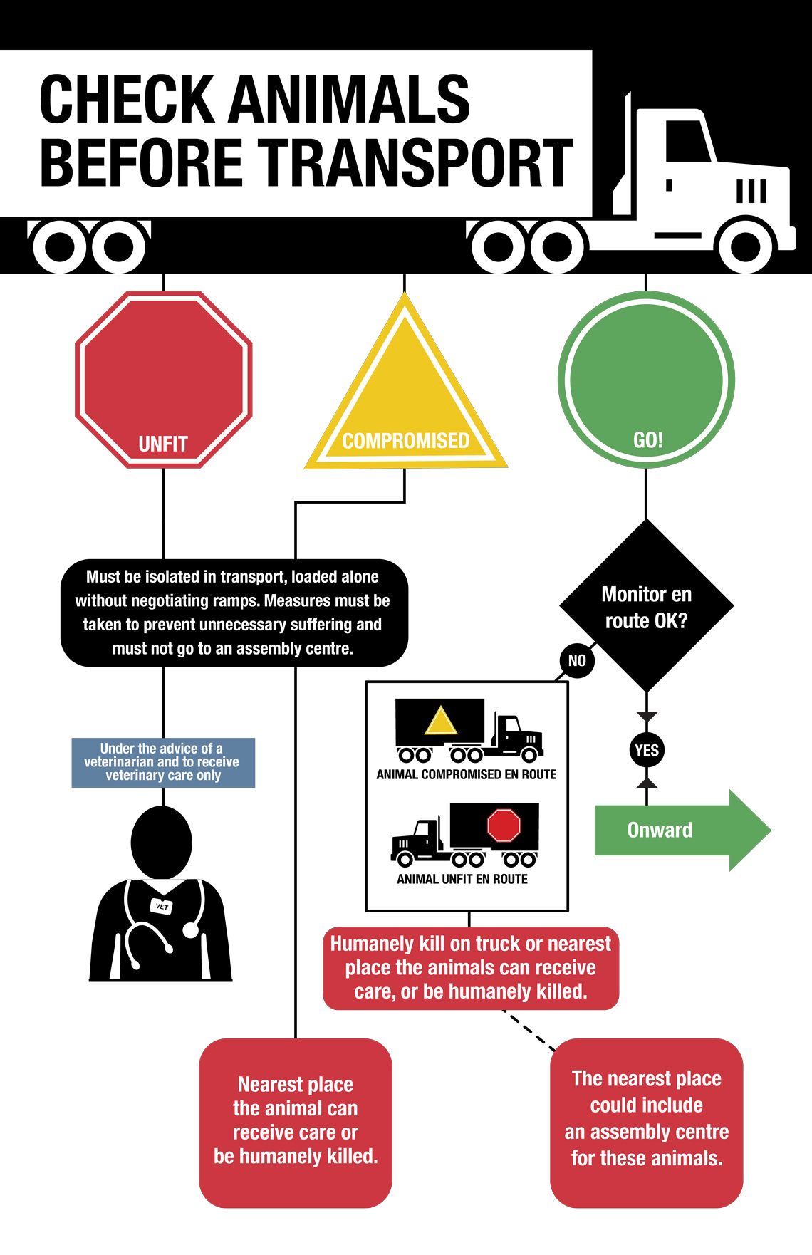
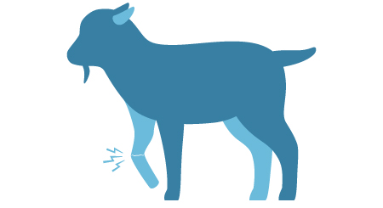
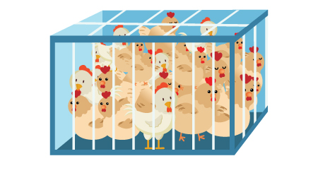
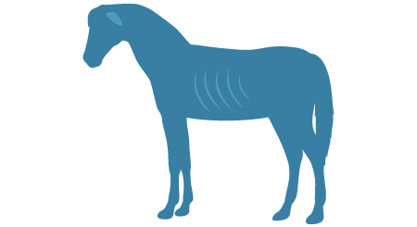

Slide 4
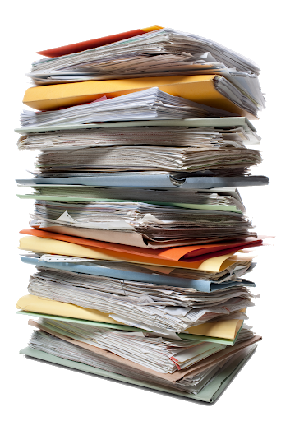
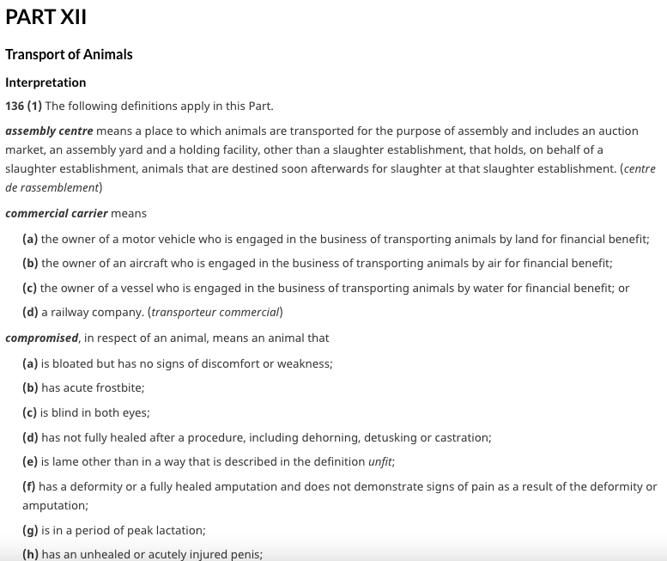
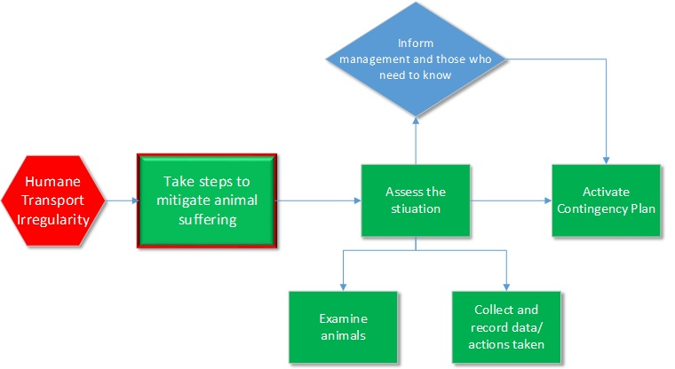
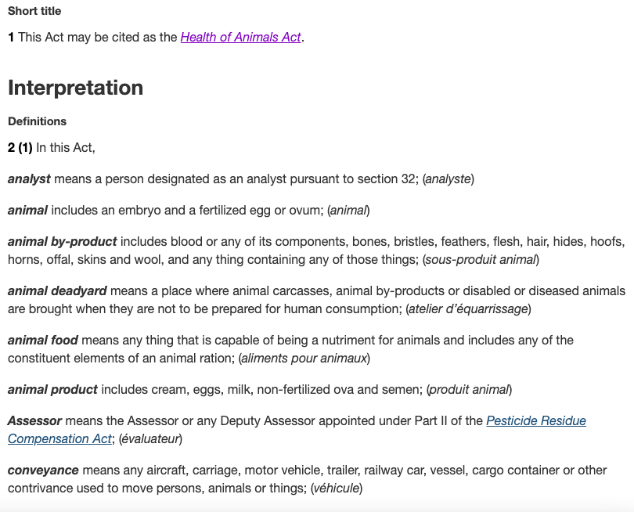
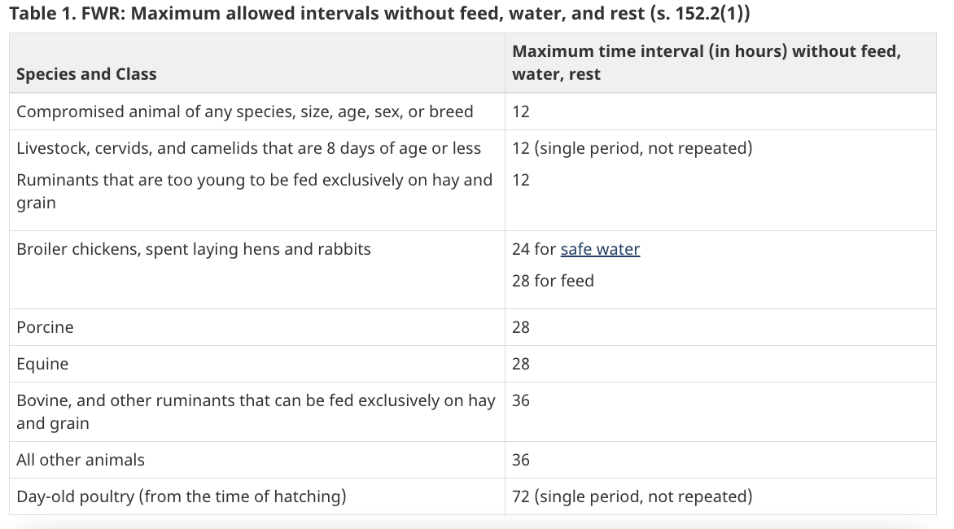
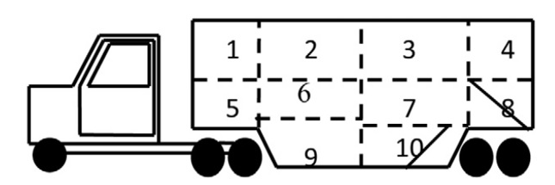

Slide 5
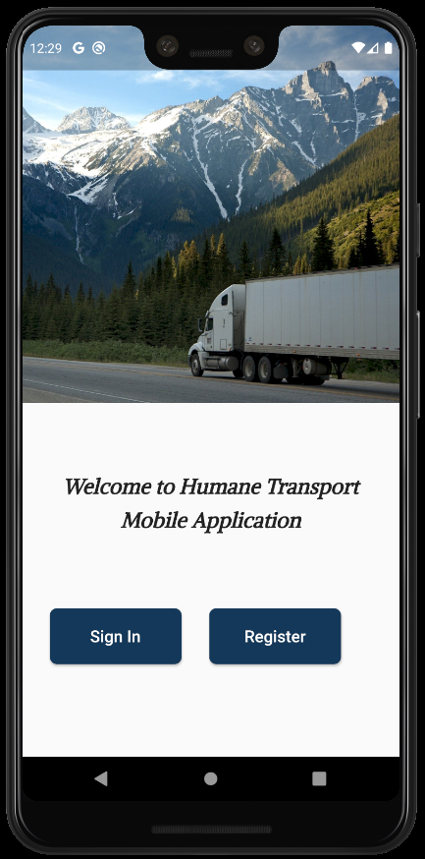

Slide 6
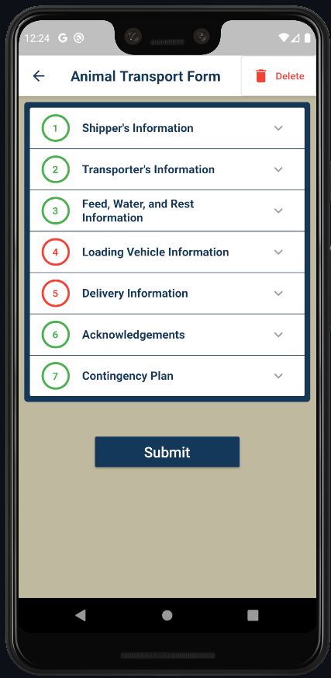
Easily Record Transport Documents
Works Offline
See Old Records Anytime
Use Images in Records
Share Records as PDF & Email
Frequently Asked Questions
Notes:
“Let’s have a look at the awesome features of this app, which solve the problems transporters face”
Slide#1 Easily Record Transport Documents
“The most important feature is that through this app transporter can easily make transport documents. Current process requires many printed forms filled by transporters to make sure that all animals and transport’s data is collected. In this app all the required forms are combined into one single form so it is easier for transporter to fill out all necessary information.”

Slide 7
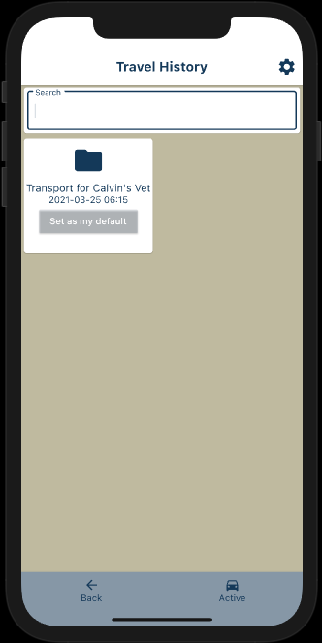
Easily Record Transport Documents
Works Offline
See Old Records Anytime
Use Images in Records
Share Records as PDF & Email
Frequently Asked Questions
Notes:
Slide#2 See Old Records
“Once transporter has submitted the Animal Transport Form, they cannot modify it and it will stored into the database. Transporter can also retrieve all the past travel history records through this app. They can even search for their past records. And you know in industry it is very hard to save or search all these paper documents. Moreover, this will save our trees and our environment.”

Slide 8
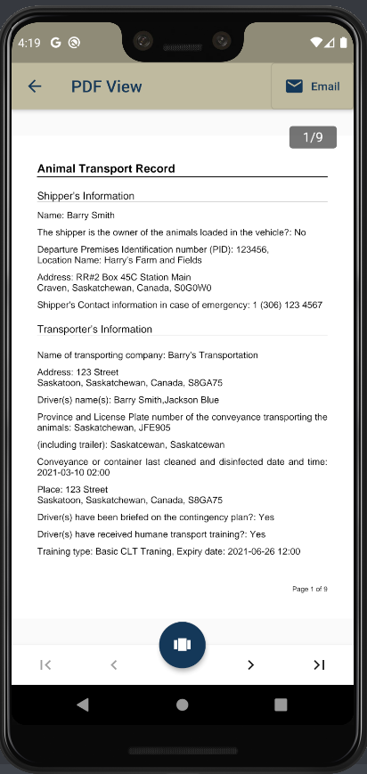
Easily Record Transport Documents
Works Offline
See Old Records Anytime
Use Images in Records
Share Records as PDF & Email
Frequently Asked Questions
Notes:
Slide#3
“Transporters can even share these travel history records as PDF and email. For example, if CFIA inspector asks for past records, transporter can simply share their record.”

Slide 9
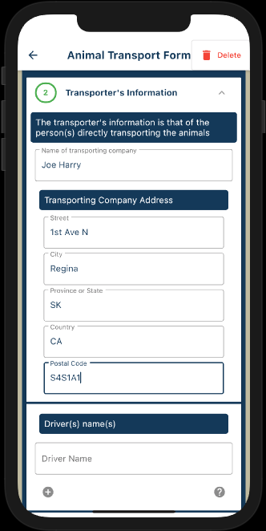
Easily Record Transport Documents
Works Offline
See Old Records Anytime
Use Images in Records
Share Records as PDF & Email
Frequently Asked Questions
Notes:
“This app also works offline. That means transporter can read and write the data when device is offline. For example, when transporter has no internet, and they has to enter information, then this app will save the information and when the device comes back online, the data will be saved automatically over the internet. That’s cool isn’t it?”

Slide 10
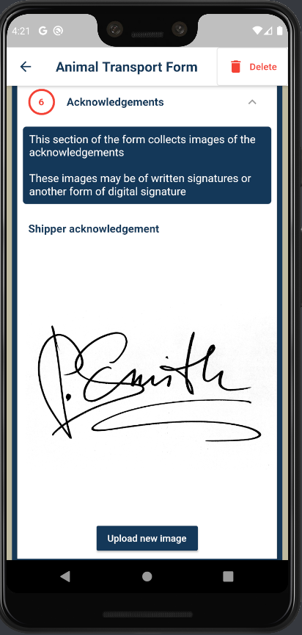
Easily Record Transport Documents
Works Offline
See Old Records Anytime
Use Images in Records
Share Records as PDF & Email
Frequently Asked Questions
Notes:
“In the form, transporter can upload signature as images. If person doesn’t know how to take digital signature, they can just sign on the paper and take photo and upload it in the form.”

Slide 11
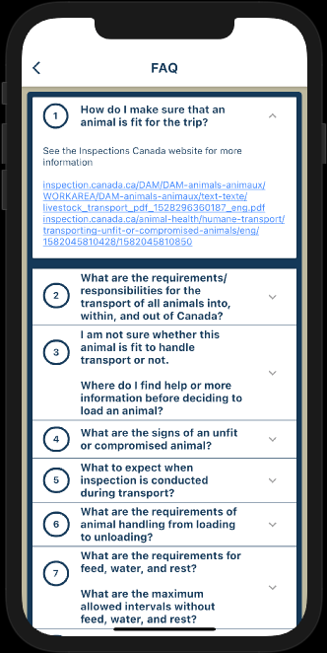
Easily Record Transport Documents
Works Offline
See Old Records Anytime
Use Images in Records
Share Records as PDF & Email
Frequently Asked Questions
Notes:
We have this questions screen which is very helpful for Transporters. This will guide transporter to determine how to handle animals safely during unloading from truck and loading them into truck. How to safely handle injured animal. Previously, transporters need to find this information on their own and now we provide it as part of our app. This will raise awareness and give transporter’s a sense of confidence.

Slide 12
How do we meet record keeping requirements?
Retrievable Records
No changes after submission
Validated forms

Slide 13
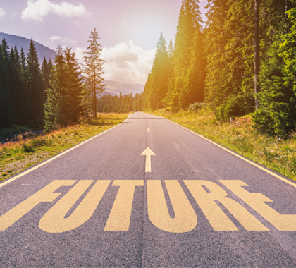
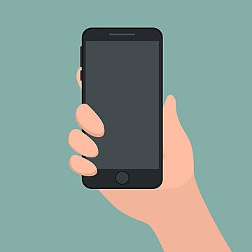

Slide 14
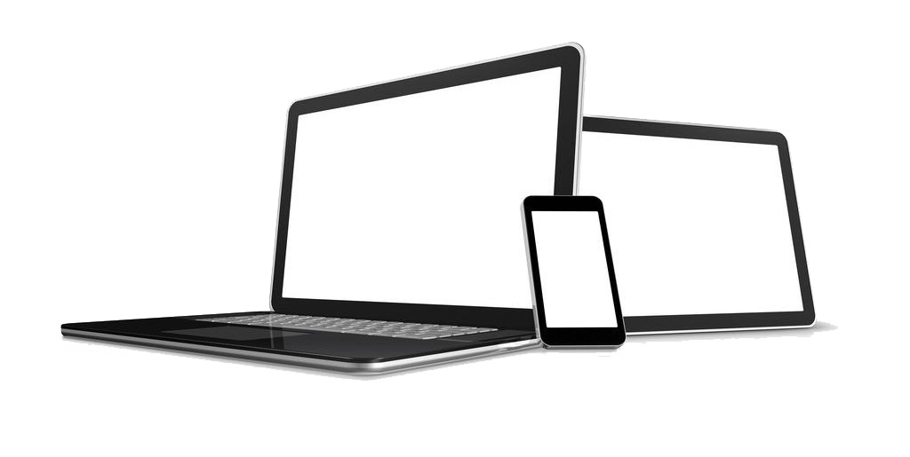
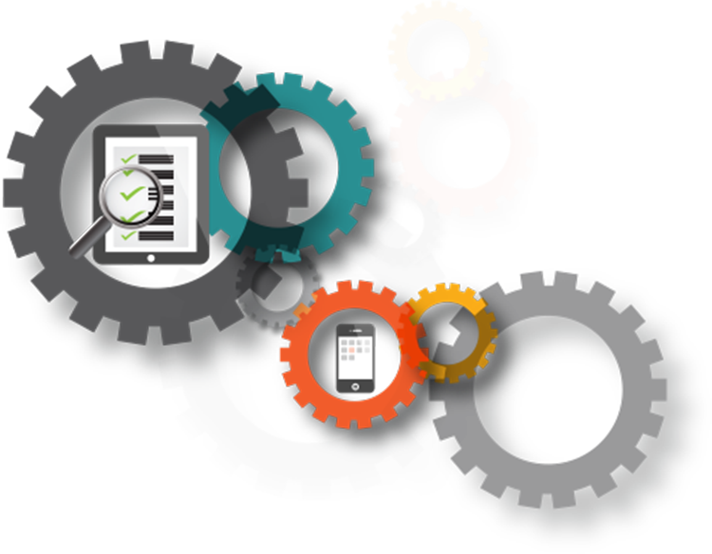
Future of our Application
Speech to Text
Responsive
Inspector Account
Testing
Database
Video Recording

Slide 15
We thank everyone who made this project possible!
Questions?
Got questions we couldn’t answer today?
Send us an email at humane.transport@gmail.com !

Slide 16
Image References
Compromised animals and check animals before transport brochure. https://inspection.canada.ca/animal-health/humane-transport/livestock-transport-in-canada/eng/1363748532198/1363748620219
HAR Pt. XII Interpretive Guidance document. https://inspection.canada.ca/animal-health/humane-transport/health-of-animals-regulations-part-xii/eng/1582126008181/1582126616914
Health of Animals Act. https://laws-lois.justice.gc.ca/eng/acts/H-3.3/page-1.html#h-253044
Stack of papers. https://www.stickpng.com/img/miscellaneous/paper/stack-of-paper
Phone stock image. https://pngtree.com/freepng/mobile-phone-held-by-one-hand_4399755.html?share=3

Slide 17
Image References
Magnifying glass. https://www.pngkit.com/bigpic/u2w7w7t4e6i1i1o0/
The future is bright. https://www.heartland.org/news-opinion/news/the-future-is-bright-at-heartland
Colorful stack of papers. http://clipart-library.com/clip-art/book-stack-transparent-background-22.htm
Phone, tablet, and laptop. https://www.cleanpng.com/png-laptop-tablet-computer-mobile-phone-mobile-device-159709/
Database. https://www.cleanpng.com/png-database-model-column-information-select-bases-de-4433502/download-png.html

Slide 18
Image References
Inspector Image. https://www.cleanpng.com/png-clip-art-computer-icons-scalable-vector-graphics-p-6108328/download-png.html
Testing. https://www.cleanpng.com/png-test-automation-software-testing-software-framewor-807000/download-png.html
Video Recording. https://www.cleanpng.com/png-video-camera-icon-cute-cartoon-camera-305306/download-png.html
Speech to Text. https://www.cleanpng.com/png-portable-network-graphics-clip-art-transparency-mi-7289179/download-png.html

